Slide 1




Rated:

Slide 2

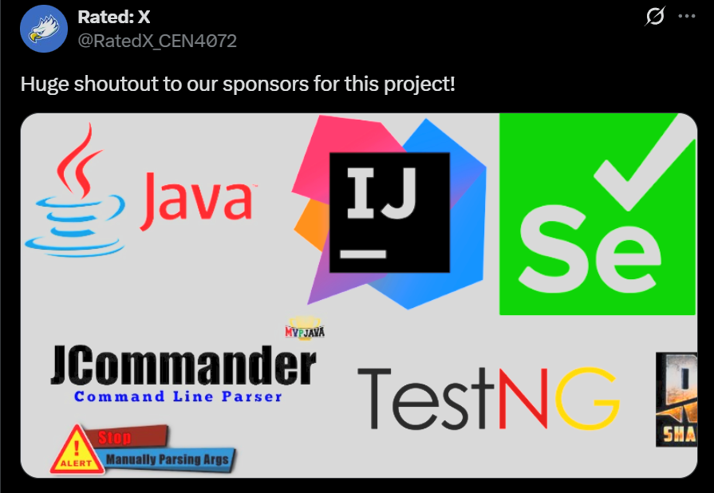

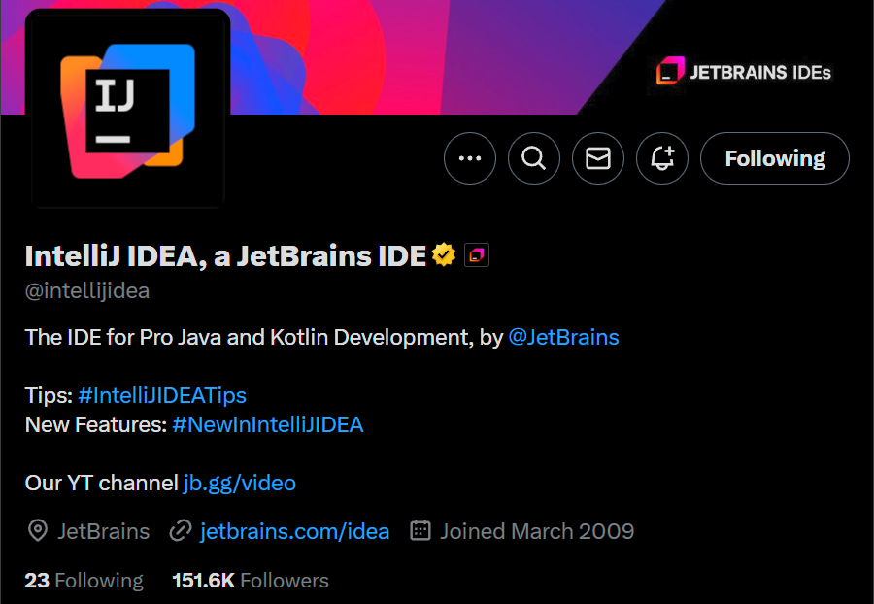
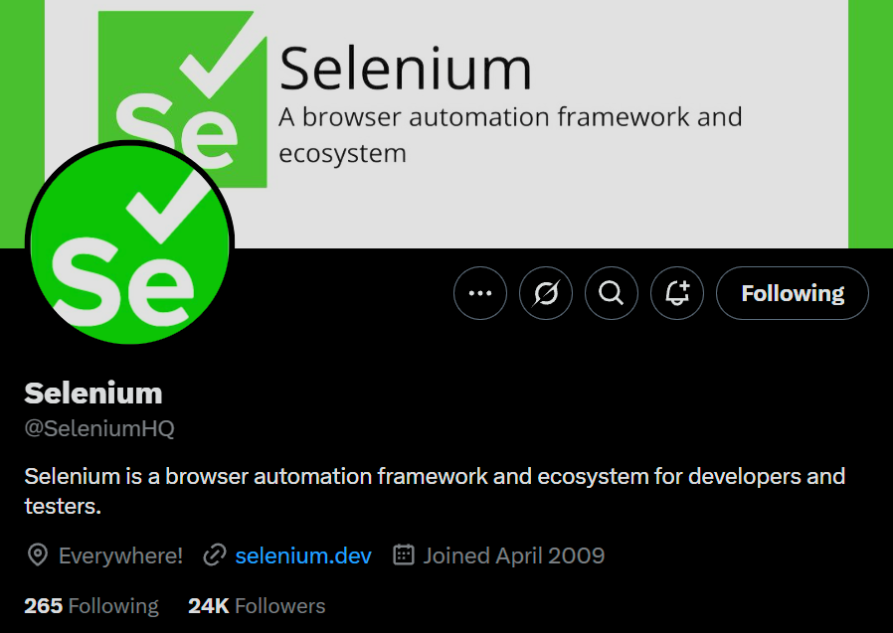
Java : A versatile, object-oriented programming language used to build secure, cross-platform applications.
IntelliJ : A powerful integrated development environment (IDE) for Java that boosts productivity with smart code assistance and tools.
Selenium : An open-source automation tool for testing web applications by simulating user interactions in a browser.
JCommander : A lightweight Java library for parsing command-line arguments, making it easy to handle input parameters.
TestNG : A testing framework for Java that supports unit, functional, and integration testing with annotations and test configuration.
ChromeDriver : A WebDriver tool that connects Selenium tests to the Chrome browser, enabling automated browser interaction.

Slide 3
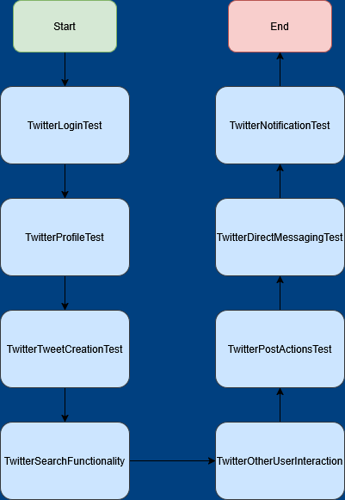
Flow diagram

Slide 4

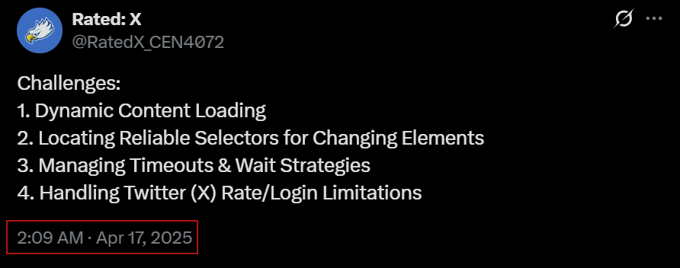
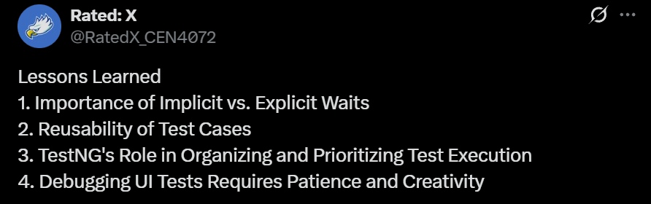
Implicit Waits: Applied globally, causing the WebDriver to wait a specified amount of time for elements to appear before throwing an exception.
Explicit Waits: Allow waiting for specific conditions to occur before proceeding, such as an element becoming clickable.
We were able to use some of the test case scenarios across some and even all of our other classes, specifically the login test case.
Using the “@Test(priority = n)” annotation allowed us to define the execution order of test cases, ensuring critical tests run first.
The grouping mechanism enabled us to categorize tests logically, facilitating targeted test runs and better organization.
No explanation needed
Modern web applications often load content asynchronously using technologies like AJAX, which can lead to elements appearing or changing after the initial page load.
Web elements have attributes that change dynamically, such as IDs or classes that are generated at runtime. This variability makes it difficult to create stable selectors for test automation.
Automated tests can fail if they attempt to interact with elements before those elements are ready, leading to exceptions and unreliable test results.
Automating interactions with platforms like Twitter introduces challenges due to their security measures designed to detect and prevent automated access.

Slide 5




Individual team member contributions

Slide 6

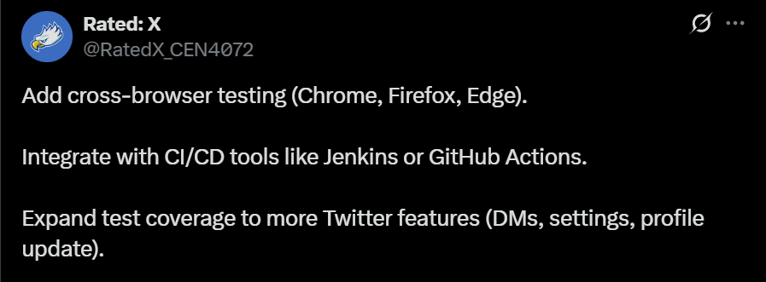
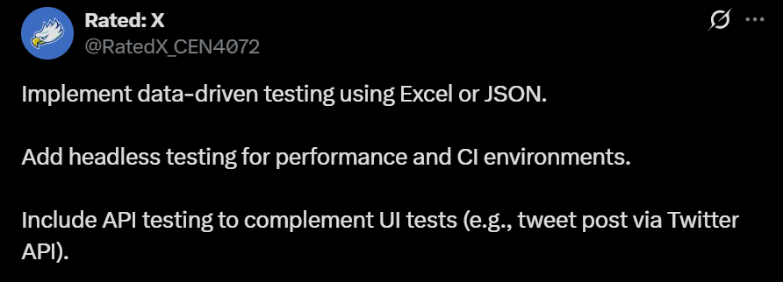

Slide 7

Test Demonstrations

